Slide 1
SoarTech Overview

Slide 2





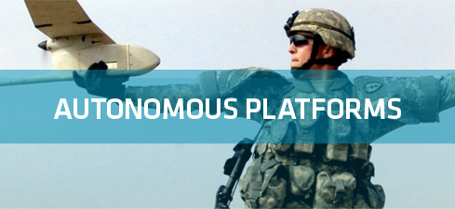
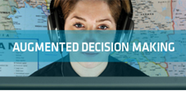
Soar Technology, Inc.
Spinoff of University of Michigan AI Lab (Soar Group)
R&D in Wide Array of Cognitive and Social Architecture Technologies
Market Segments
Full spectrum behavior models
Individually varied training
Serious games
Control for Autonomous Platforms
Human-Robot Interfaces
Mixed Initiative Control
Intelligent User Interfaces
Behavior Modeling and Prediction
Reactive Planning
Focus Areas
TACSAFs (ONR)
PercepTS (ONR)
SSIM (DARPA)
RedRef (AFRL)
POL EDGE (STTC)
VESIP (Dept. of Education)
SUMET (ONR)
AACUS (ONR)
Smart Interaction Devices (multiple)
TRUFAST (ONR)
WEAVER (ONR)
ANSRS (DARPA)
INSIGHT (DARPA)
Technology
Applications

Slide 3
Warfighter Problems × Technology Innovations
Intelligent Training
Unmanned Platforms
Data to Decisions
Full Spectrum Behavior Models
Autonomy Stack for UxVs
Automated Analysis of
Social Media
Autonomy
Cloud Autonomy & Situated Instruction
Individualized, Varied Training
Abductive Reasoning
Adaptation
Human/System Interface
Simulation to Instruction & Multimodal Student Sensing
Smart Interaction Devices
Adaptive User
Interfaces

Slide 4
SoarTech is growing by leaps and bounds
 | Jul 2011 | Jan 2012 | Apr 2012 | Target EOY 2012 | Actual EOY 2012 | June 2013
Total Staff | 26 | 34 | 44 | 45
Geographic
Michigan | 21 | 26 | 30 | 32
Florida | 2 | 4 | 6 | 6
North Carolina | 1 | 1 | 2 | 2
Maine | 1 | 1 | 1 | 1
California | 1 | 2 | 2 | 2
Colorado |  |  | 1 | 1
Oregon |  |  | 1 | 1
Vermont
Area
Management | 4 | 4 | 4 | 4
Admin | 3 | 3 | 5 | 5
Researcher | 10 | 11 | 14 | 16
Project Manager
Engineer | 8 | 16 | 18 | 20
Intern | 1 | 1 | 3

Slide 5
SoarTech is growing by leaps and bounds
 | Jul 2011 | Jan 2012 | Apr 2012 | Target EOY 2012 | Actual EOY 2012 | June 2013
Total Staff | 26 | 34 | 44 | 45 | 58 | 57
Geographic
Michigan | 21 | 26 | 30 | 32 | 43 | 44
Florida | 2 | 4 | 6 | 6 | 6 | 6
North Carolina | 1 | 1 | 2 | 2 | 3 | 3
Maine | 1 | 1 | 1 | 1 | 1 | 1
California | 1 | 2 | 2 | 2 | 2 | 1
Colorado |  |  | 1 | 1 | 1
Oregon |  |  | 1 | 1 | 1 | 1
Vermont |  |  |  |  | 1 | 1
Area
Management | 4 | 4 | 4 | 4 | 4 | 3
Admin | 3 | 3 | 5 | 5 | 7 | 7
Researcher | 10 | 11 | 14 | 16 | 17 | 16
Project Manager |  |  |  |  | 2 | 2
Engineer | 8 | 16 | 18 | 20 | 27 | 27
Intern | 1 | 1 | 3 |  | 1 | 2

Slide 6
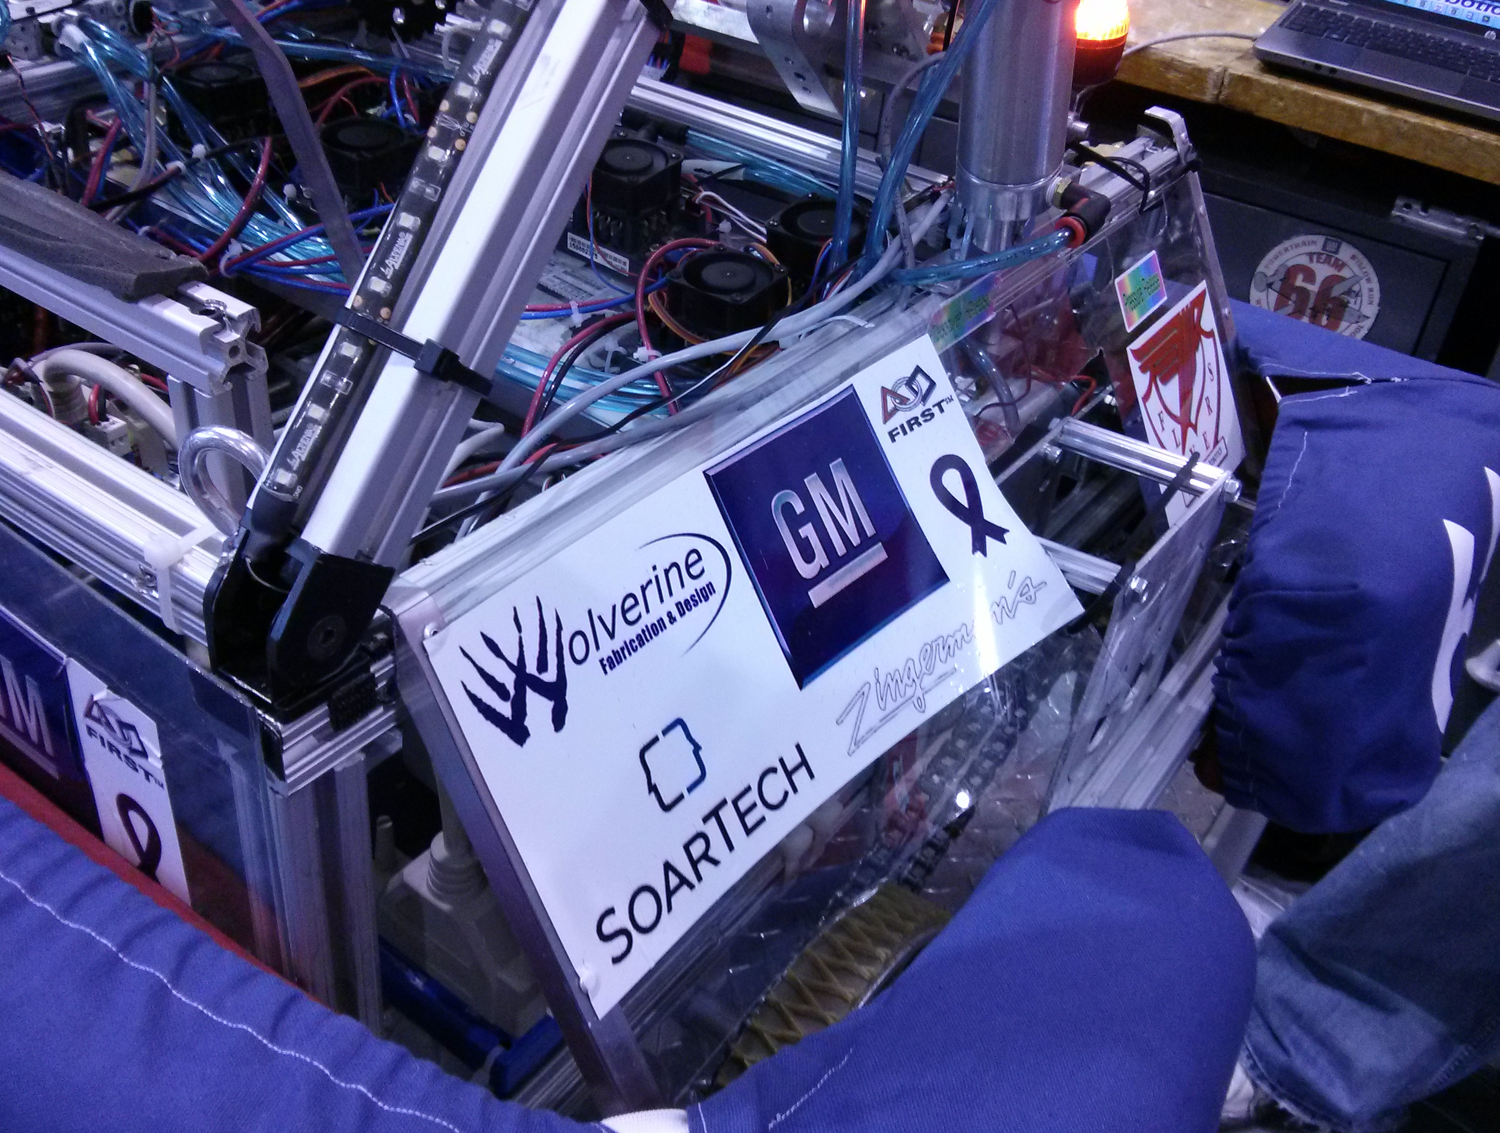
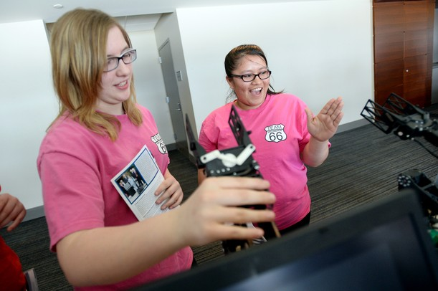
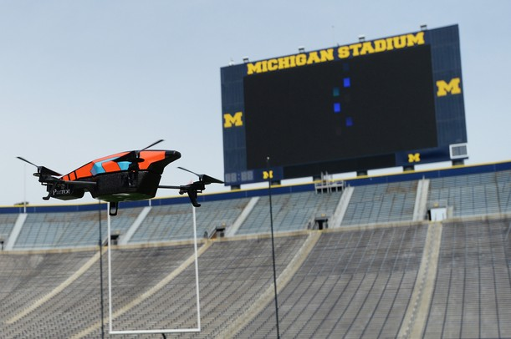

Community Outreach: Michigan Robotics Day and FIRST sponsorship
Michigan Robotics Day
Attendance is growing rapidly
2011: 150 people
2012: 200 people
2013: 550 people
SoarTech is a founding member of Michigan Robotics Day and a sponsor
SoarTech (Andy Dallas) organized the Industry Panel with representatives from Beaumont Hospital, Pratt & Miller, Cybernet, GM, UMTRI
Support and Sponsorship of FIRST Team 66
The Flyers from Willow Run HS

Slide 7
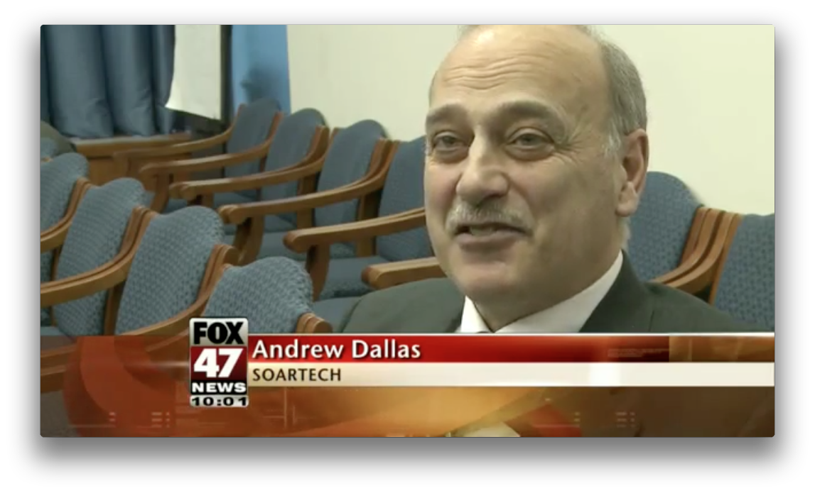
SoarTech in the News

Slide 8
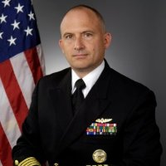
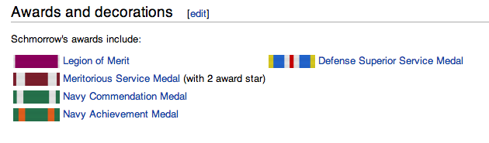
CAPT Dylan Schmorrow
Dylan will be joining SoarTech on July 8th as Chief Scientist
Career summary
Currently Deputy Director, Human Performance, Training and BioSystems at Office of the Secretary of Defense (2008-2013)
Program Manager at ONR: 1999 – 2008
Program Manager at DARPA: 200-2005
Chief Scientist for Human-Technology Integration at NRL: 1998-2001
Assistant Professor at Naval Postgraduate School: 1996-1998
Ph.D. in Experimental Psychology from Western Michigan University

Slide 9
Contributions to the Soar community
jSoar
Working on a combination of internal funding and project funding to bring jSoar up to date with Soar 9.3.
jSoar is open source.
Working on a plan for long-term support of jSoar.
See Bob Marinier’s talk.
Additions to SML
Adding features to SML based on the features of ATE that SML is missing.
TCL-support, logging…
Extensions to SML will be made open source (once we’re proud of them).
Talk to Jon Voigt.
SimRadio
A simulated radio framework with hooks into Soar.
SimRadio will be made open source (once we’re proud of it).
See Jon Voigt’s talk.

Slide 10
Nuggets and Coal
Nuggets
Growth
Strong financial forecasts
Transition success with WEAVER
Increased focus on Soar including Soar 9’s new features
Increased collaboration with university partners
Coal
Growth
Uncertainty of future DoD budgets
Suffering from the lack of experienced Soar model developers

